Slide 1
Finding Stories in Data

Slide 2
Contents
The Data Journalism Process
Data sources: recurring events
Exercise
Data sources: sent or leaked data
Data sources: breaking news
Data sources: theories to be explored
Exercise
Summary & References

Slide 3
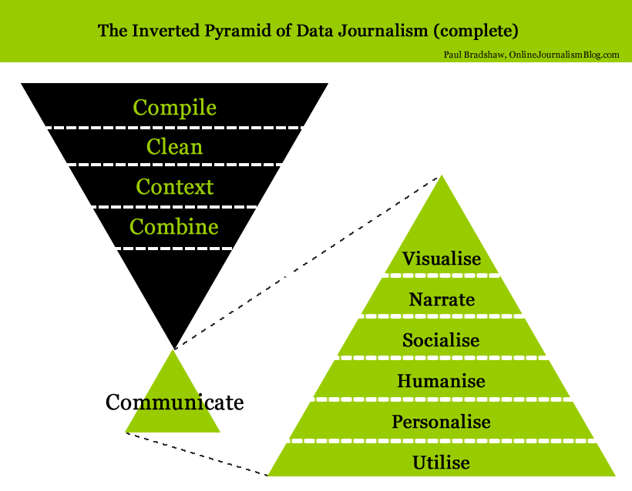
The Data Journalism Process

Slide 4
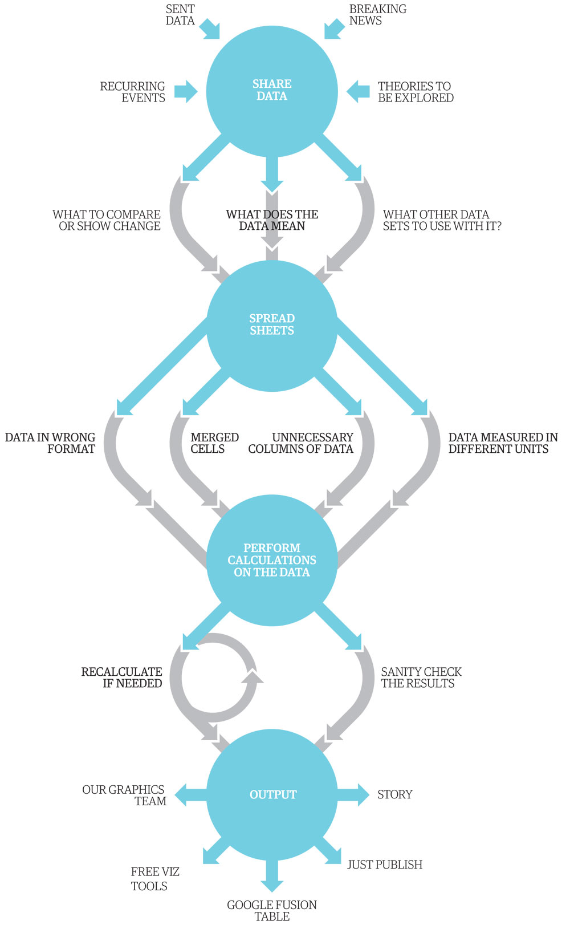
The Data Journalism Process The Guardian: 1. Share Data 2. Spread Sheets 3. Perform Calculations 4. Output

Slide 5
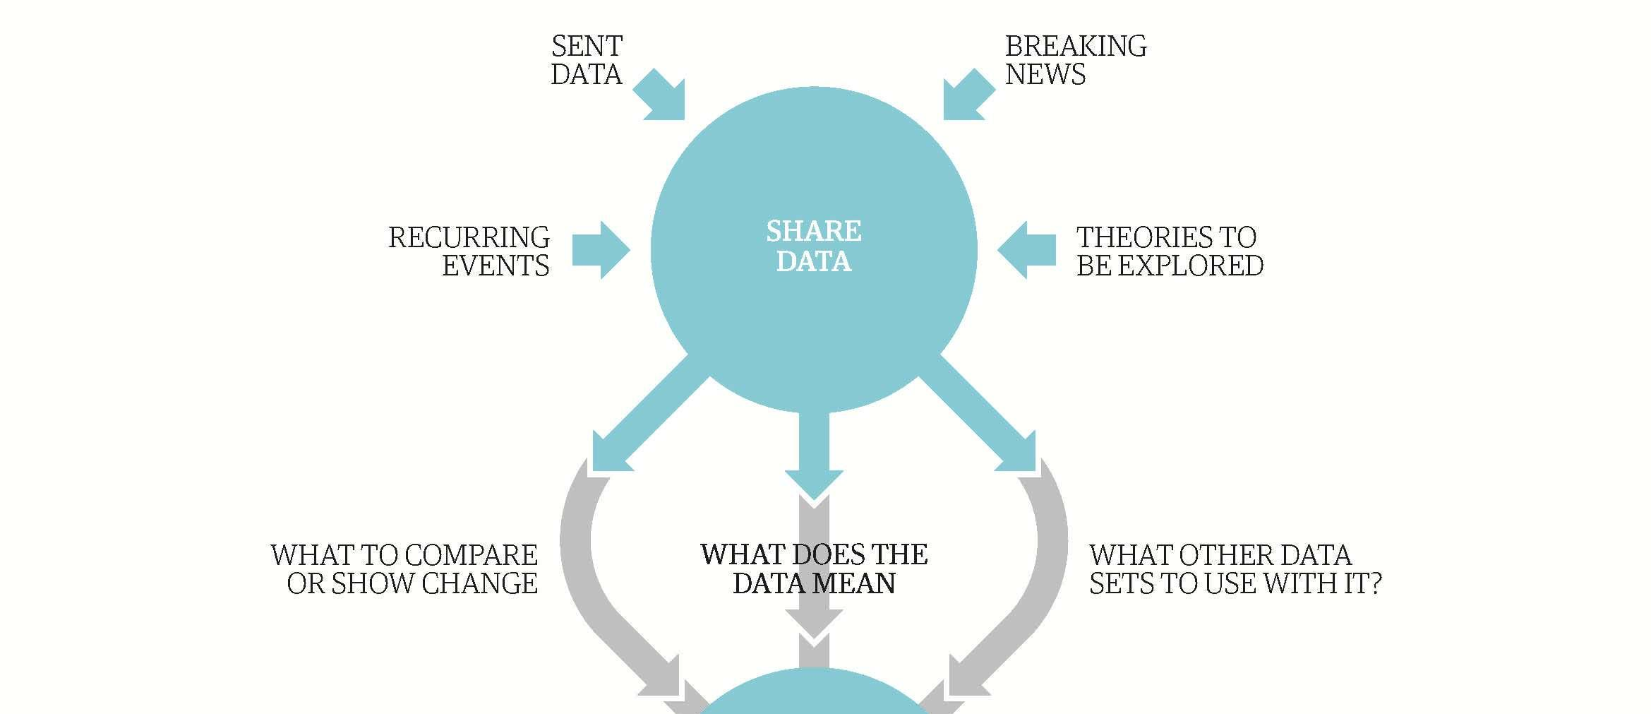
The Data Journalism Process

Slide 6
Data sources
Data sources: recurring events
Data sources: sent or leaked data
Data sources: breaking news
Data sources: theories to be explored

Slide 7
Data sources
Data sources: recurring events
Governance & Security Indicators
Economic Indicators & Budgets
Education Indicators
Human rights & Equality Indicators
Environmental Indicators
Health Indicators

Slide 8
Data sources
Data sources: recurring events
Governance & Security Indicators
Economic Indicators & Budgets
Education Indicators
Human rights & Equality Indicators
Environmental Indicators
Health Indicators

Slide 9
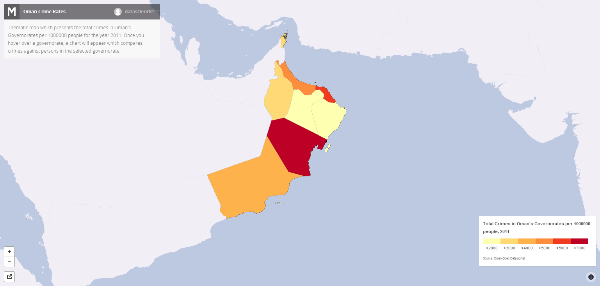
Data Sources: Recurring Events
Crime In Oman Visualized: For the first time, the government of Oman released crime data, which was visualized by a local blogger

Slide 10
Data Sources
Data Sources: recurring events
Governance & Security Indicators
Economic Indicators & Budgets
Education Indicators
Human rights & Equality Indicators
Environmental Indicators
Health Indicators

Slide 11
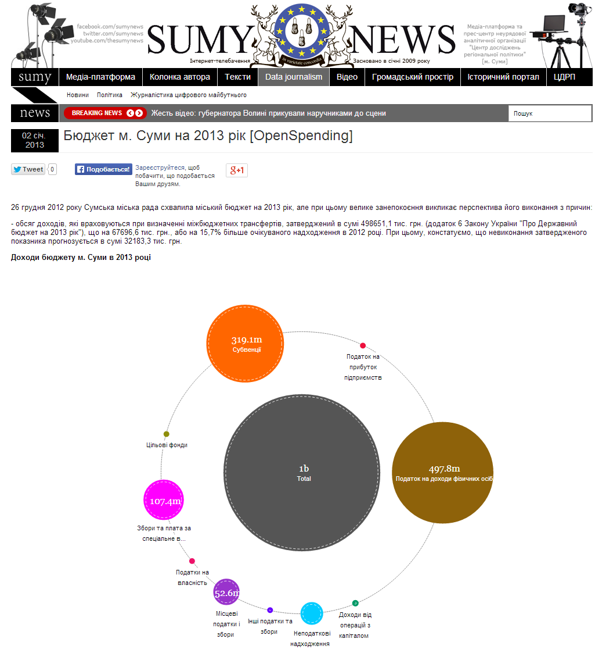
Data Sources: Recurring Events
Ukraine 2013 budget: A Ukrainian newspaper created an interactive data visualization when the government released its annual budget so that citizens could evaluate how the government is spending its tax dollars

Slide 12
Data Sources
Data Sources: recurring events
Governance & Security Indicators
Economic Indicators & Budgets
Education Indicators
Human rights & Equality Indicators
Environmental Indicators
Health Indicators

Slide 13
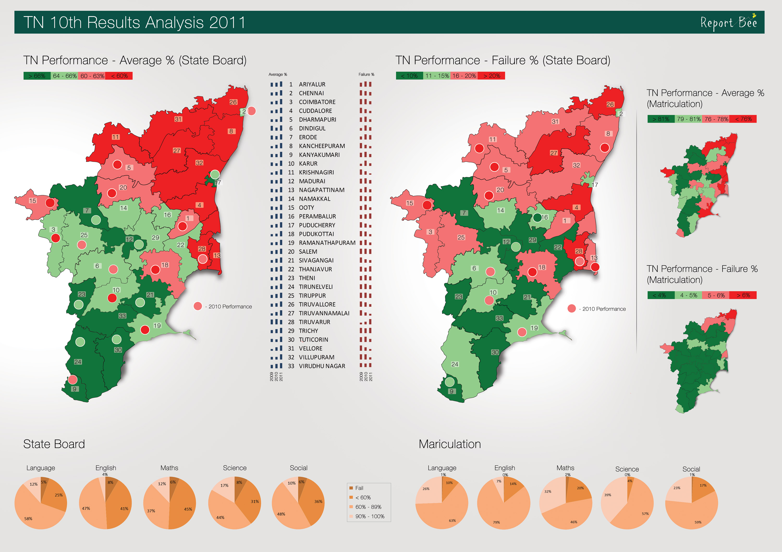
Data sources: Recurring Events
2011 Tamilnadu School Performance: India’s Reporter Bee visualized the performance of different school districts based on annual performance reports.

Slide 14
Data Sources
Data Sources: recurring events
Governance & Security Indicators
Economic Indicators & Budgets
Education Indicators
Human rights & Equality Indicators
Environmental Indicators
Health Indicators

Slide 15
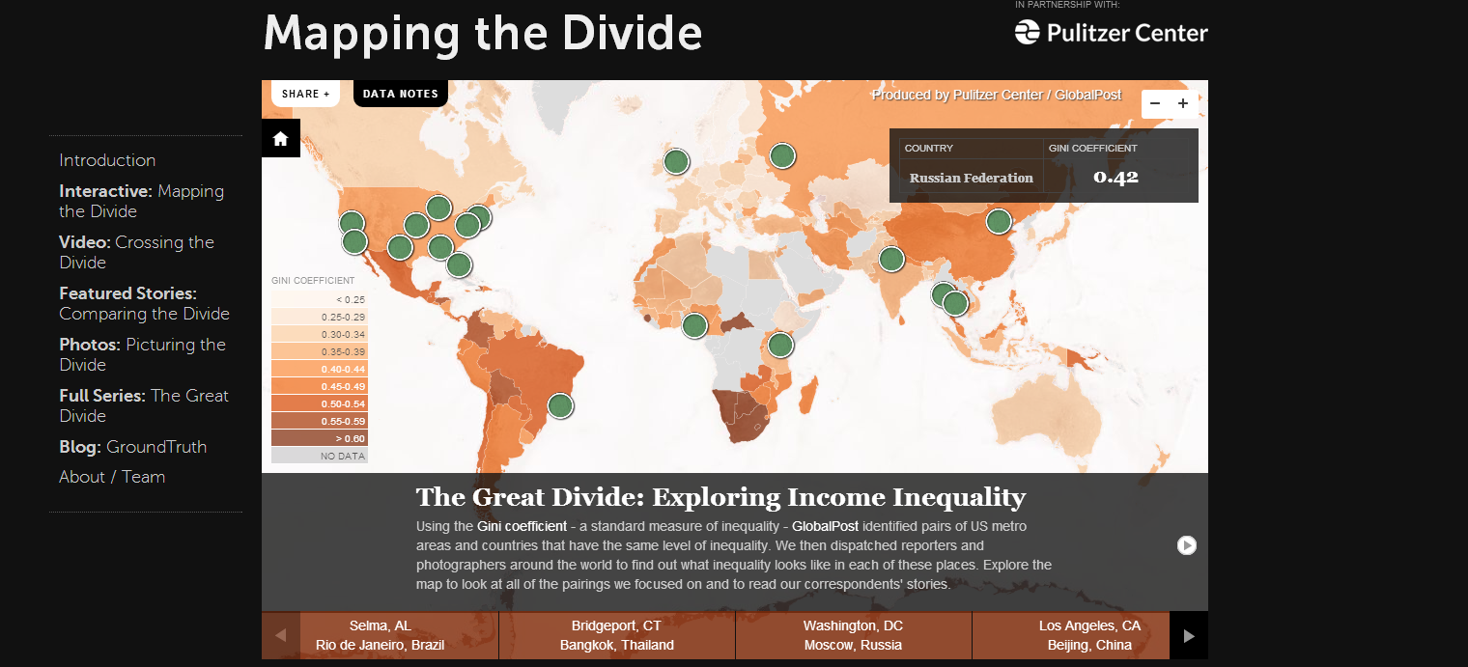
Data sources: Recurring Events
The Great Divide Global Income Inequality: The Global Post maps annual data on global inequality by country and compares cities with similar levels of inequality.

Slide 16
Data Sources
Data Sources: recurring events
Governance & Security Indicators
Economic Indicators & Budgets
Education Indicators
Human rights & Equality Indicators
Environmental Indicators
Health Indicators

Slide 17
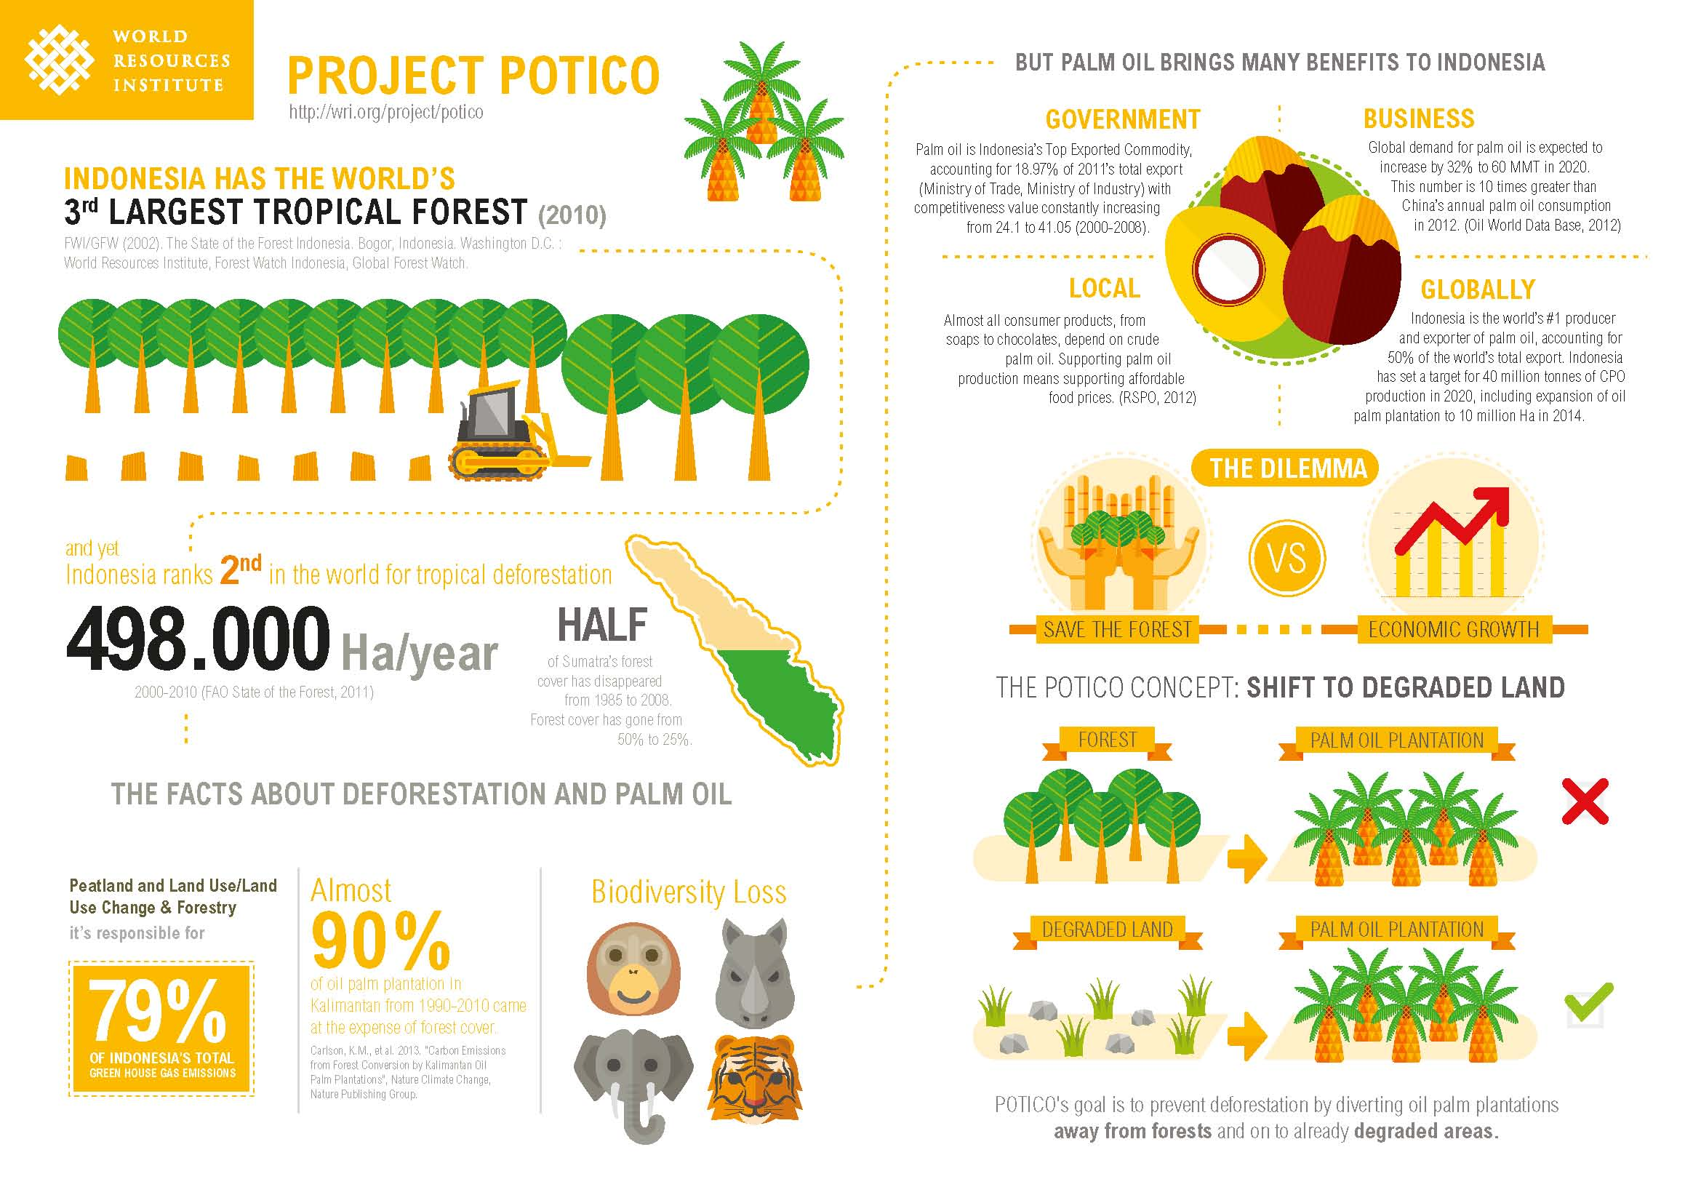
Data sources: Recurring Events
Project Potico: World Resource Institute explores deforestation in Indonesia

Slide 18
Data Sources
Data Sources: recurring events
Governance & Security Indicators
Economic Indicators & Budgets
Education Indicators
Human rights & Equality Indicators
Environmental Indicators
Health Indicators

Slide 19
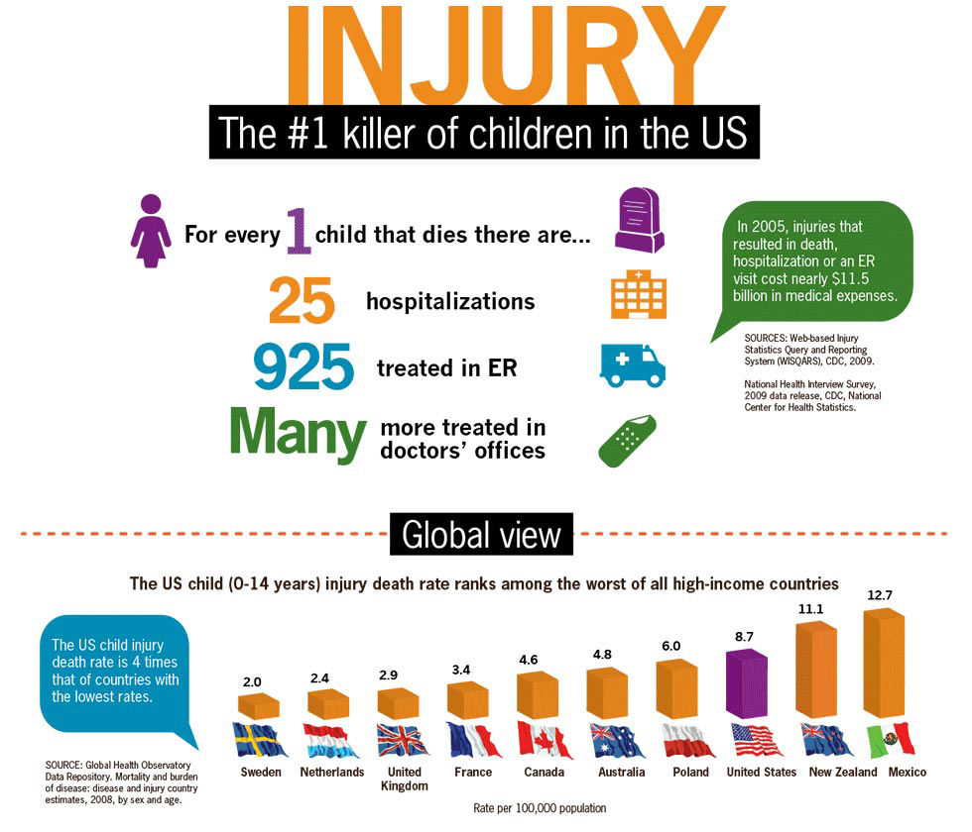
Sources of Data: Recurring Events
Child Injury: The Center for Disease Control in the United States created this infographic for journalists to draw attention to a major health risk for children

Slide 20
Contents
The Data Journalism Process
Data sources: recurring events
Exercise
Data sources: sent or leaked data
Data sources: breaking news
Data sources: theories to be explored
Exercise
Summary & References

Slide 21
Exercise
Key Point #2: Parliament should demand adequate justification for specific allocations in the 2014/15 budget, such as “free maternity” Health
For the second year, the budget introduces funds for the “free maternity” programme without a clear policy guideline or explanation of funding levels. The PBB allocates roughly Ksh 4 billion for the “Maternity” sub-programme of the Ministry of Health. The narrative also indicates that the total cost of free maternity and elimination of all user charges in health facilities is Ksh 4.5 billion. If that is correct, the cost of eliminating user fees is only Ksh 500 million. However, the Budget Summary states that Ksh 700 million is allocated for elimination of user fees. Note that there is no indication of where that 500 million (or Ksh 700 million) is located in the PBB (the total estimate for the Maternal and Child Health Programme, which contains the Maternity sub-programme, is only 4.3 billion, and contains funds for other purposes, such as immunization).
The figure for the Maternal and Child Health Programmes of Ksh 4.31 billion seems to roughly correspond to a figure in the MOH development budget in the traditional budget books (administrative classification) for “Family Planning Maternal and Child Health” of Ksh 4.36 billion. It is not clear what the source of the minor difference between the figures is, but there is a capital grant of exactly Ksh 4.04 billion in the breakdown which is equivalent to the PBB budget for “Maternity” of Ksh 4.04 billion.

Slide 22
Exercise
Key Point #2: Parliament should demand adequate justification for specific allocations in the 2014/15 budget, such as “free maternity” Health
If this is indeed the figure for “free maternity,” then it has not changed much from last year, when it was Ksh 4.063 billion. Even if the Ksh 4 billion was sufficient last year, it is unlikely to be sufficient this year, given expected inflation of 5% (BPS 2014). It is hard to understand why the funding for this flagship programme is actually decreasing in real terms, rather than increasing.
The main question Parliament must ask is: what is the basis for these figures, and why are they not increasing over time? There is no evidence of which we are aware that justifies these figures. Given that maternal health is a county function, the requirement to abolish fees and the use of a conditional grant to replace those fees, requires an analysis of costs that avoids a situation where counties are forced to pick up the costs for a national programme. The constitution is clear that finance must follow function, and if the national government wants counties to pay for free maternity, it must provide adequate funds to cover the actual costs of that programme. Currently, this looks like it may be an “unfunded mandate” for counties, which is both bad public finance, and unconstitutional.

Slide 23
Exercise
Review Visualization:
The Right Priorities Revisited?

Slide 24
Exercise
How could these recurring reports be used in your health reporting?
What would your story angle be?
What additional data would you need?
What experts would you talk to?

Slide 25
Contents
The Data Journalism Process
Data sources: recurring events
Exercise
Data sources: sent or leaked data
Data sources: breaking news
Data sources: theories to be explored
Exercise
Summary & References

Slide 26
Data Sources: Sent or Leaked Data
Wikileaks in Kenya
The Looting of Kenya published by The Guardian in 2007.
Kennya: The Cry of Blood - Report on Extra-Judicial Killings and Disappearances - the Kenya National Commission on Human Rights (KNCHR) 2008.
Bringing international attention to corruption issues too dangerous to print in-country.
Project Potico: World Resource Institute explores deforestation in Indonesia

Slide 27
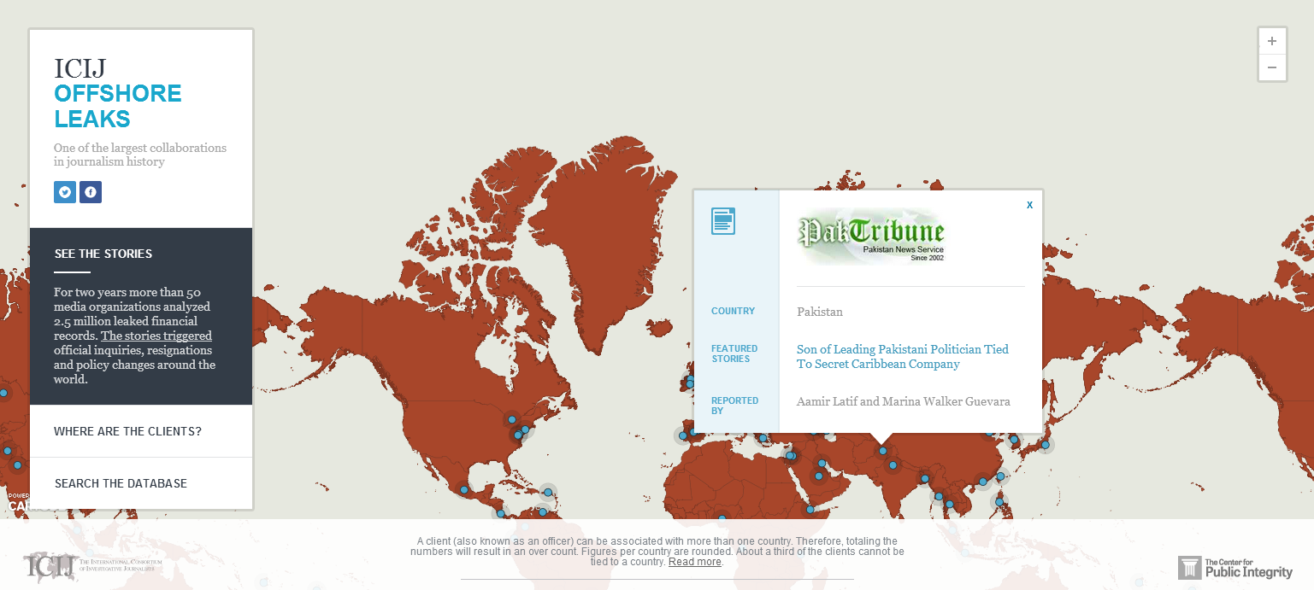
Data sources: sent or leaked data
Offshore Leaks: A leaked hard drive of 2.5 million documents about offshore bank accounts to the International Consortium of Investigative Journalists

Slide 28
Contents
The Data Journalism Process
Data sources: recurring events
Exercise
Data sources: sent or leaked data
Data sources: breaking news
Data sources: theories to be explored
Exercise
Summary & References

Slide 29
Data Sources: Breaking News
Data collection:
Crowd-sourcing via Ushahidi-type platforms
Citizen media contributions
Sensor data for environmental catstrophes
Risks:
Selection bias
Verification process
Context

Slide 30
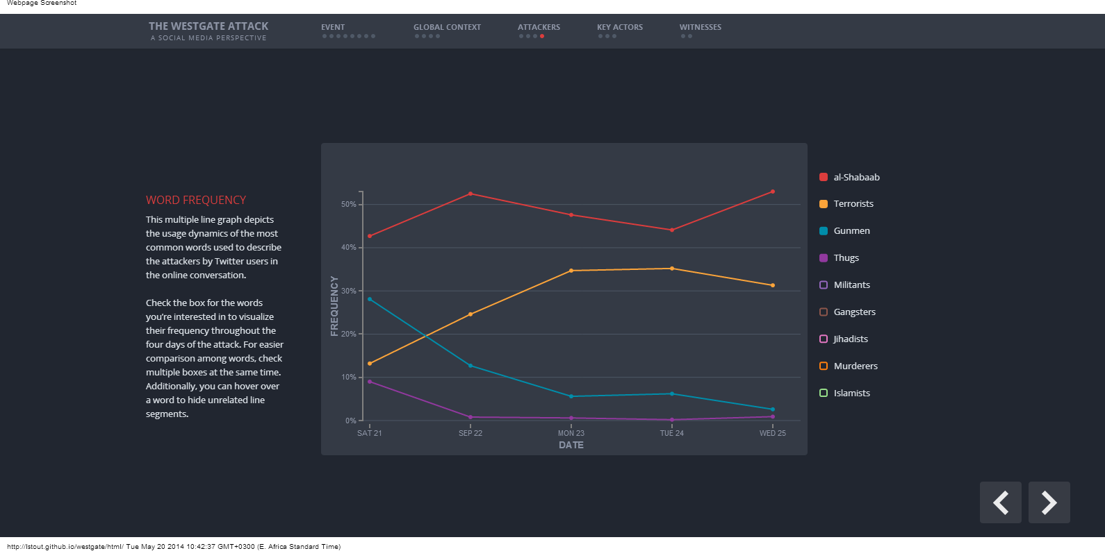
Data sources: breaking news
The Westgate Attack: A Social Media Perspective: An analysis of the events of Westgate driven by analysis of social media content.

Slide 31
Data Sources: Theories to be Explored
Global and open data catalogs
World Health Organization
United Nations
World Bank
DataCatalogs.org
The Guardian's world government data portal
Google's public data directory
The data hub
DBPedia Datasets
Factual
Free GIS data
List of open data resources
Energy data repositories
World Research Institute
Data wrangling
Quora thread: "Where can I find large datasets open to the public?"
Directory of APIs
Infochimps
Datamarket
Offshore Leaks
Investigative Dashboard
Open Corporates
Natural Earth data
UNEP Data
Transparency International Corruption Index
Land Ownership Database
Gapminder World

Slide 32
Data Sources: Theories to be explored
Kenyan Data Sources
Mars Group
Africa Open Data
Kenya National Bureau of Statistics
E-promis Kenya
International Budget Partnership County Budgets
Kenya Open Data Initiative
Kenya Health Data
World Bank Boost
Kenya Demographic Health Survey
Internews Data Dredger
Kenya Service Delivery Indicators

Slide 33
Exercise
Divide into two groups and read:
Red flag raised as drug abuse hits Eldoret schools, colleges
7 people succumb to killer brew in Eldoret

Slide 34
Exercise
Answer
What is the journalist’s hypothesis or theory?
What topics does the journalist cover in the story?
What does he or she want the reader to understand after reading the story?

Slide 35
Exercise
Answer
2. What is the journalist’s evidence for the story?
What data does he or she use to prove his hypothesis?
What experts does he or she quote?
Do the experts explain or enrich the data findings?

Slide 36
Exercise
Answer
3. What information and data is missing?
What other data is missing to give the story context?
What would your data angle for the story be?

Slide 37
Contents
The Data Journalism Process
Data sources: recurring events
Exercise
Data sources: sent or leaked data
Data sources: breaking news
Data sources: theories to be explored
Exercise
Summary & References

Slide 38
Summary & Resources
Data sources include recurring events, sent or leaked data, breaking news and theories to be explored.
Data from these stories can be used to enrich traditional reporting, find new angles on old stories, uncover corruption or engage citizens in the reporting process.
Data sources are all around us: NGOs, research institutions, government and ordinary people.

Slide 39
Summary & Resources
Datadrivenjournalism.net mailing list
School of Data mailing list
IndiaSpend
Guardian Data
Visual Loop
Global Investigative Journalism Network

Slide 40




Summary & Resources

